Slide 1
Ecphrastic poetry & the development of professional literacy in history

Slide 2
What is ecphrastic poetry?
Ecphrastic poetry is the conversation between two pieces of art. The writer interprets a work of visual art and then creates a narrative in verse form that represents his or her reaction to that painting, photograph, sculpture or other artistic creation.
http://www.firkinfiction.com/11.html

Slide 3
Ecphrastic poetry and history
How do you write a history-related poem ecphrastically?
Complete the following steps:
View a stimulus image and identify a history-related concept it evokes.
If required, write down the concept, definition, law, formula etc.
Identify a suitable poetry type and write the poem.

Slide 4
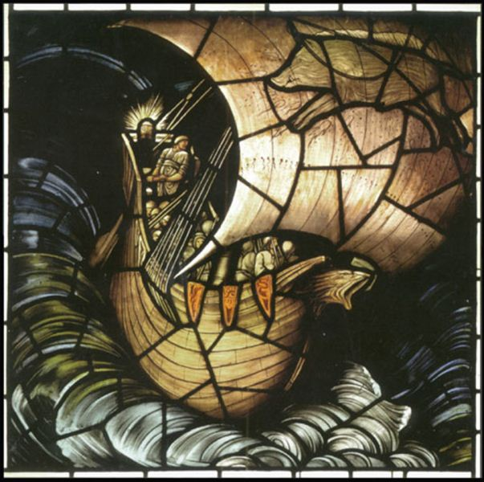
What concept does this image evoke?
http://www.krepcio.com/vitreosity/archives/VIKINGpanel500-2.jpg

Slide 5
The Vikings

Slide 6
Example Haiku poem
From the North they come,
to steal from monasteries,
then return to sea.

Slide 7
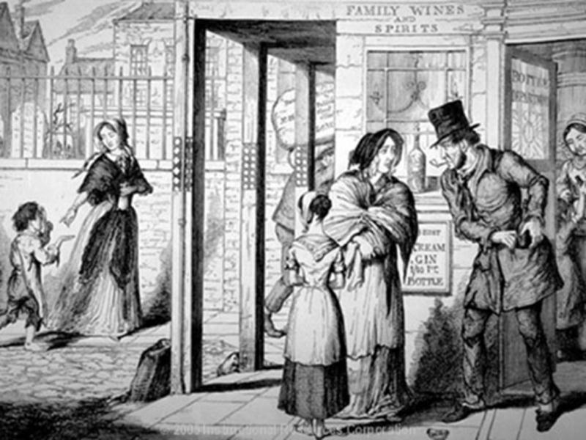
What concept does this image evoke?
http://kelseydp.edublogs.org/files/2011/05/temperance-movement-wqo6w2.jpg

Slide 8
Temperance theme Anti-alcohol movement

Slide 9
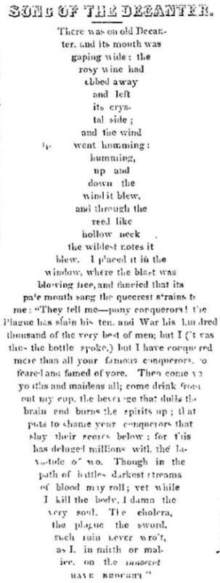
Example Concrete poem
http://yesteryearsnews.files.wordpress.com/2011/01/poem-concrete-song-of-the-decanter-1849.jpg

Slide 10
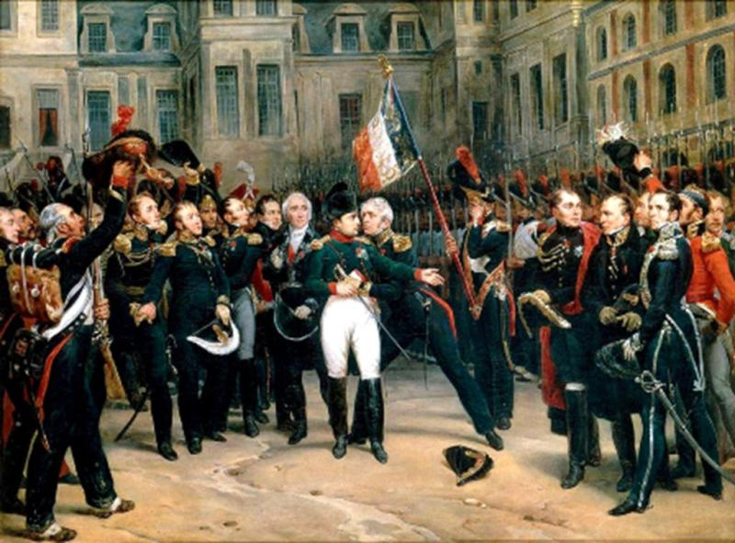
What concept does this image evoke?
http://upload.wikimedia.org/wikipedia/commons/2/25/Montfort_-_Adieux_de_Napoleon_a_la_Garde_imperiale.jpg

Slide 11
Napoleon Bonaparte

Slide 12
Example Acrostic poem
Napoleon Bonaparte, was 5’3 tall
A great leader of France
Political and army leader
Often sought for conquers
Liberated France from Robespierre
Emperor of France in 1804
One of the world’s greatest generals
Napoleonic code‘s influence on civil law is argubly lasting legacy

Slide 13
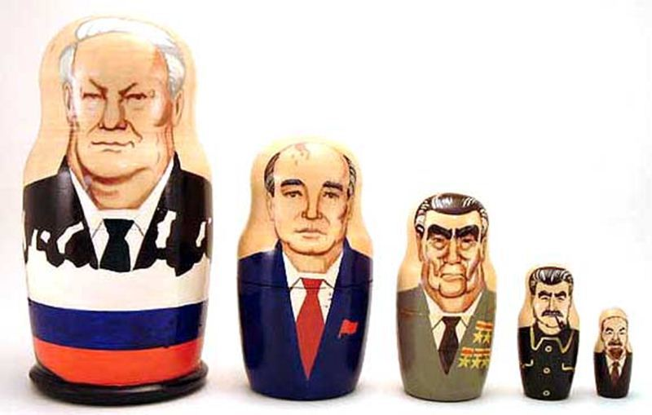
What concept does this image evoke?
https://www.collectiblereview.com/images/DSCF2509.jpg

Slide 14
The end of the Cold War

Slide 15
Example Limerick poem
Mikhail Gorbachev did what was right,
While restraining the Soviet might;
"Perestroika" was new,
"Glastnost" overdue,
The Cold War he thawed without fight.
http://www.poeticlimericks.com/honorroll.html

Slide 16
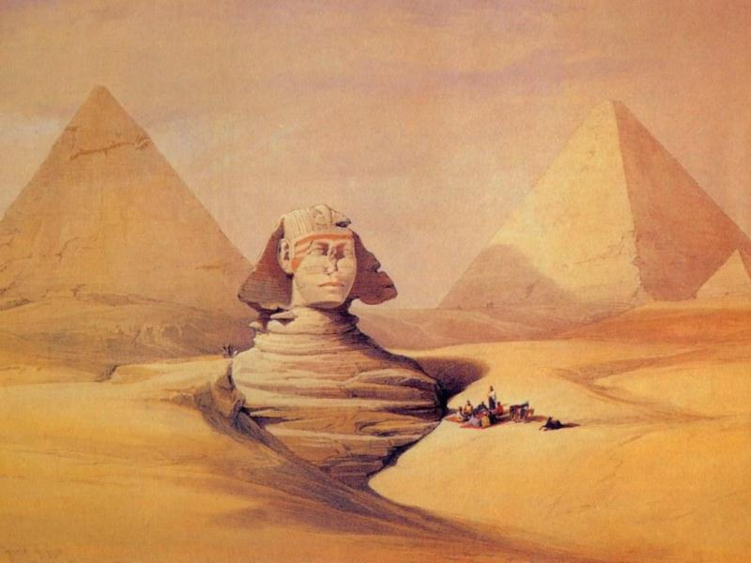
What concept does this image evoke?
http://www.9freepictures.com/d/file/art-online/200911/david-roberts-ancient-egyptian-painting-135-14.jpg

Slide 17
The Egyptian Civilisation

Slide 18
Example Free Verse poem
We are the Ancient Egyptians
You really have to admire us.
We built the mighty pyramids,
And we invented papyrus.
About three thousand years ago
We were the world's top nation.
We'll tell you a bit about ourselves
For your appreciation.
http://www.history-for-kids.com/ancient-egypt-for-kids.html

Slide 19

Example Free Verse poem
This is Egyptian writing,
It's called a hieroglyphic.
We write with pretty pictures,
Isn't that terrific?
We made the giant pyramids
Triangle shaped, not square.
If you go to Egypt now
You can still find them there.
http://www.history-for-kids.com/ancient-egypt-for-kids.html

Slide 20
Example Free Verse poem
Egyptians worshipped many gods,
Like Ra, the god of the sun.
There was Horus and Monthu, Anubis, Seth, Shu,
And the king of the gods, Amun.
Our kings were known as "Pharoahs",
There were many through the years.
We'll tell you about the most famous ones
Starting in the next verse.
http://www.history-for-kids.com/ancient-egypt-for-kids.html

Slide 21
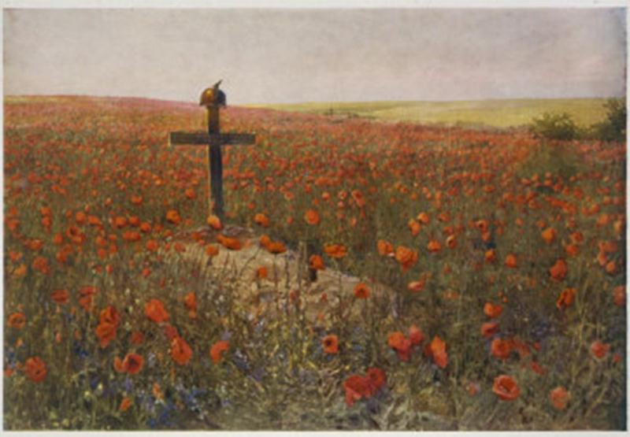
What concept does this image evoke?
http://3.bp.blogspot.com/_PqIct0Q_Rr0/TNwRiAlJGII/AAAAAAAAAs8/TGEpO6ladUc/s640/Flanders+Field.jpg

Slide 22
World War I

Slide 23
Example Cinquain poem
World War I
devastating, hurtful
fighting, killing, destroying
fear, pain, hatred, sorrow
Death
http://worldhistoryfantasycamp.blogspot.com/2007/11/create-world-war-one-cinquain-poem.html

Slide 24
What concept does this musical composition evoke?
Money, money, money by the ABBA.

Slide 25
Henry VIII and his wives

Slide 26
Example re-worked song lyric
Henry, Henry, Henry, had so many,
wives that had to die.
Henry, Henry, Henry, had so many,
only one survived.
Six wives in all!
Oh the things they could do
If they hadn‘t married Henry
That was their downfall.
http://www.youtube.com/user/historyteachers#p/search/0/3EGzHsye71c

Slide 27
Activity
Using the given stimulus material, create the following types of poetry:
Free verse
Acrostic
Cinquain
Haiku
Limerick

Slide 28
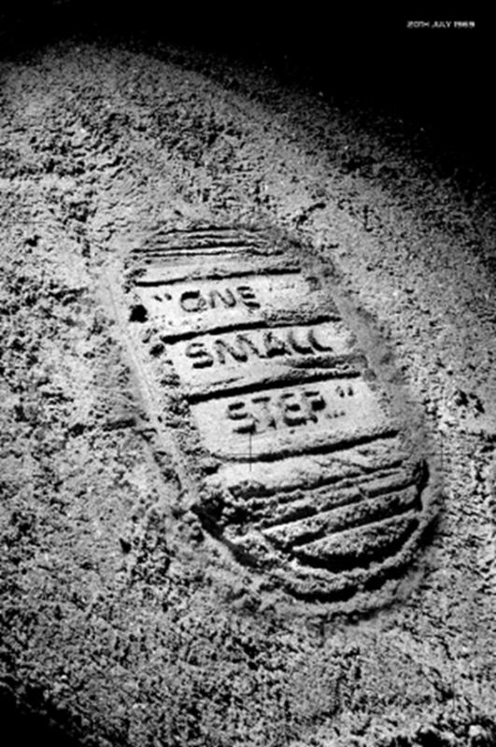
STIMULUS IMAGE 1
http://9500160365samuelbrandner.files.wordpress.com/2010/09/luna-footprint2.jpg

Slide 29
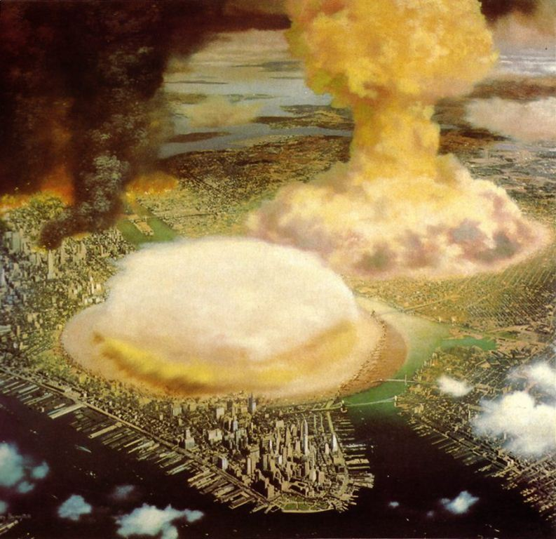
STIMULUS IMAGE 2
http://www.fabiofeminofantascience.org/BONESTELL/nukebonestell.jpg

Slide 30
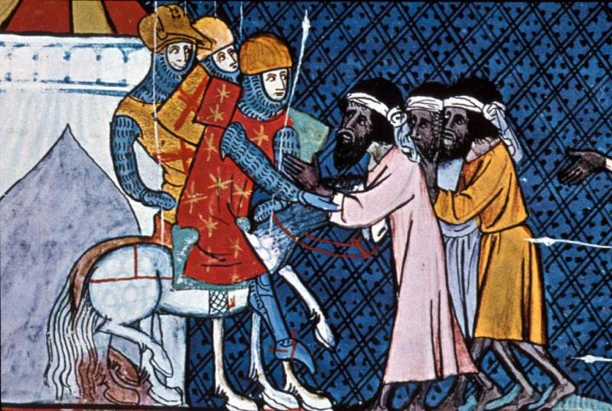
STIMULUS IMAGE 3
http://www.usu.edu/markdamen/1320Hist&Civ/slides/15crusad/crusaders&moslems.jpg

Slide 31
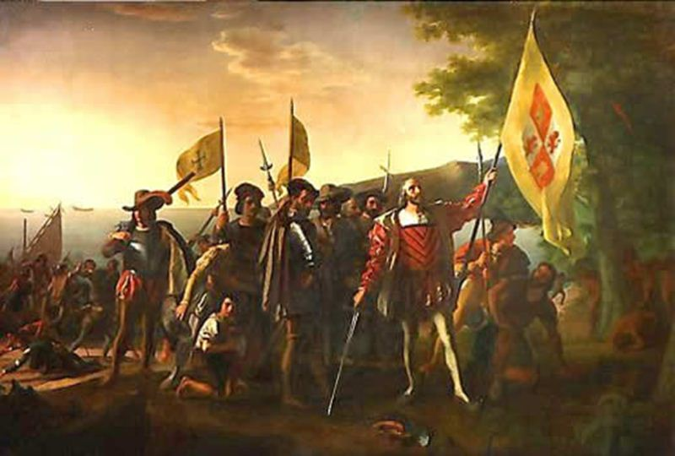
STIMULUS IMAGE 4
http://theundergroundconservative.files.wordpress.com/2011/10/landing_columbus.jpg

Slide 32
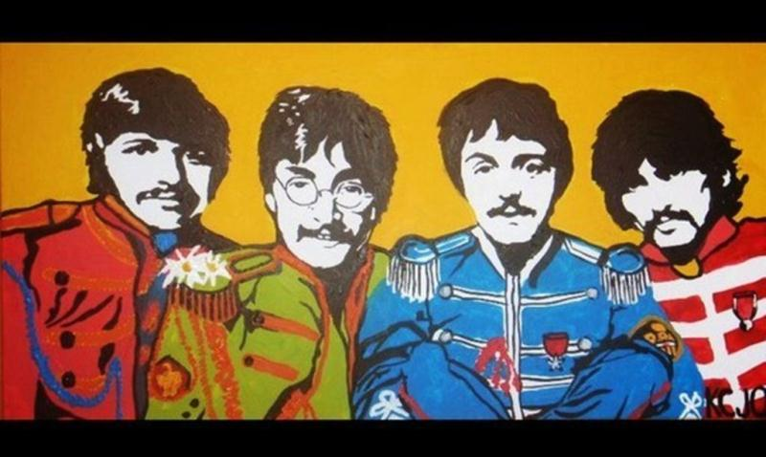
STIMULUS IMAGE 5
http://images4.fanpop.com/image/photos/17200000/Beatles-painting-for-sale-the-beatles-17295325-570-341.jpg

